Slide 1
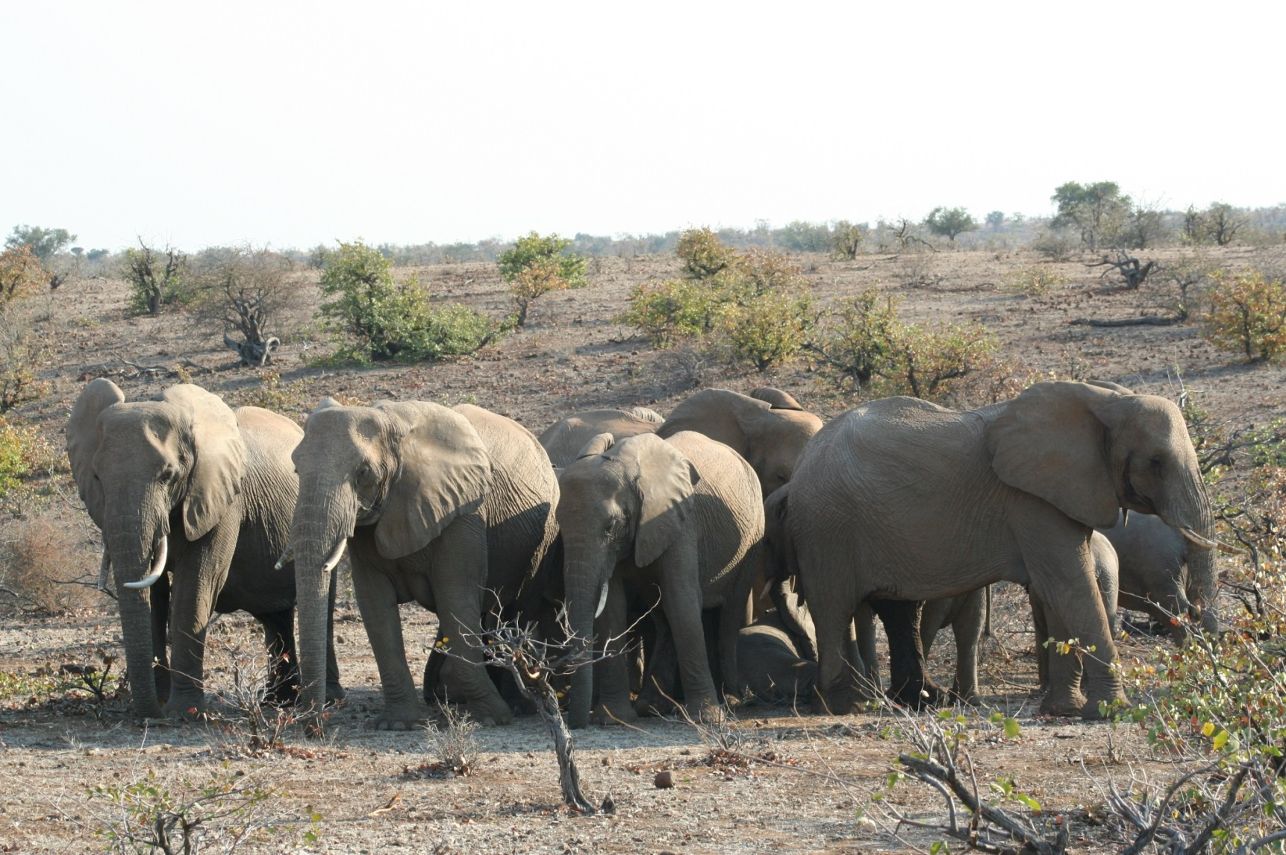
Managing the almighty elephant
Dr Jeanetta Selier
South African National Biodiversity Institute
Extra ordinary research Fellow Faculty of Law, North-West University
Honorary research fellow, School of Life Sciences, University of KwaZulu-Natal
Kinship Conservation Fellow
Notes:
Stephen Jay Gould once said “ The most erroneous stories are those we think we know best - and therefore never scrutinise or question.”

Slide 2
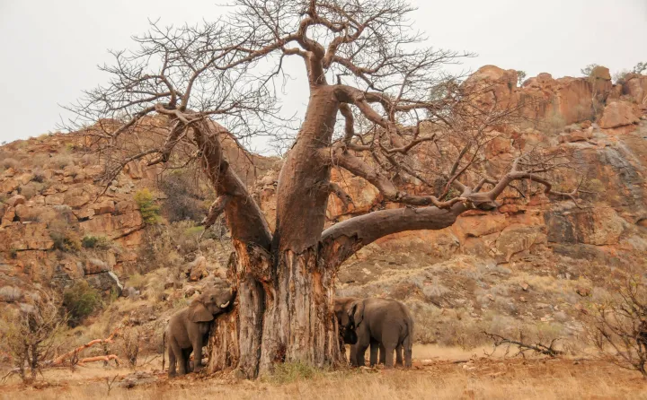
Notes:
What do you see when you look at this picture? Some will look at the herd of elephants, others will see the destruction of the baobab tree and very few will see the ecosystem processes taking place. Each will have a perception of what is happening, a value judgement, for some it will be there are too many elephants. As scientists and ecosystem managers we also have our perceptions and values, but we have the responsibility to put these aside and look at the facts, to manage systems effectively.

Slide 3
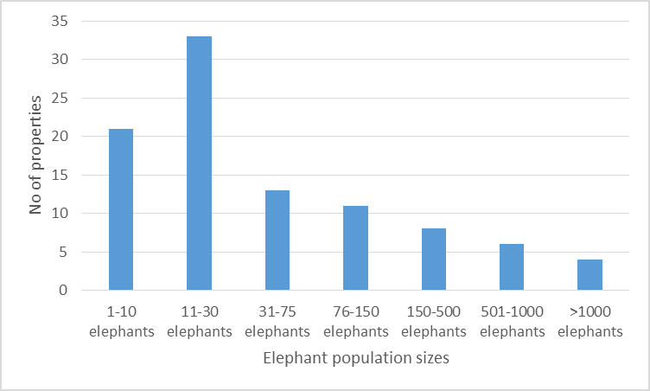
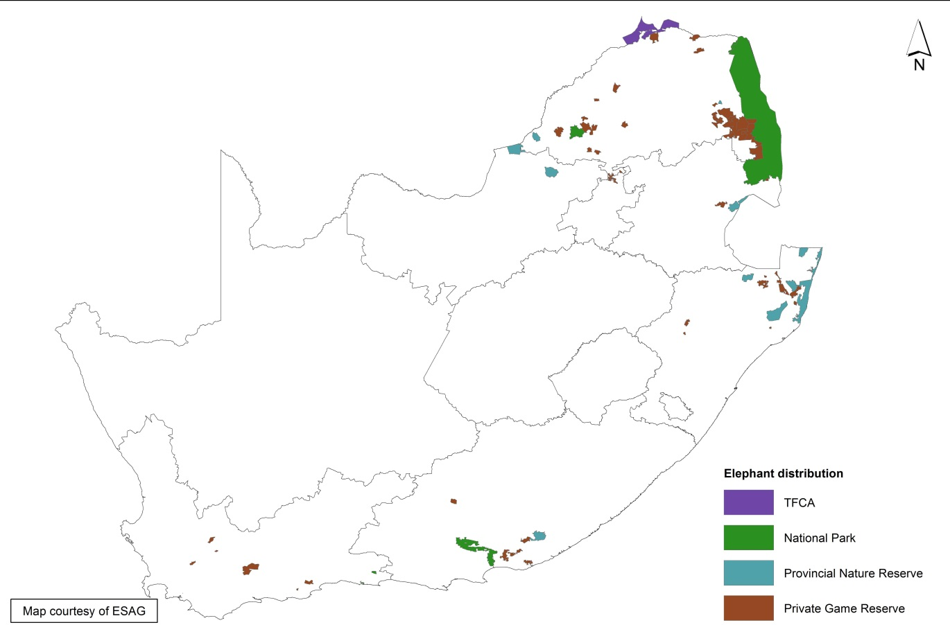
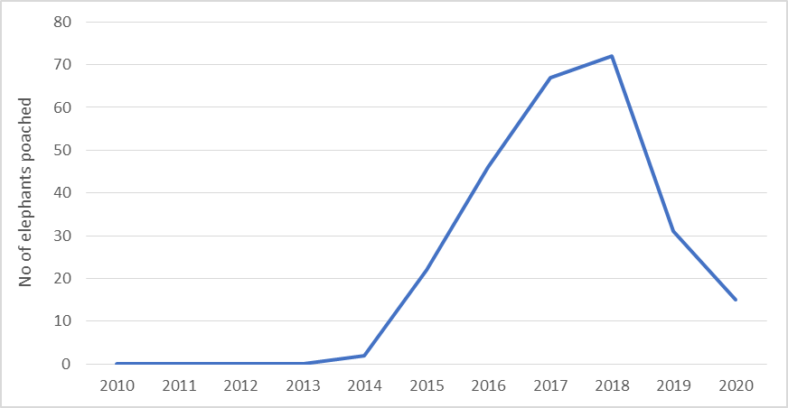

 | Number of elephants
State Protected Areas | 34,202 (33,760-34,651)
Contractual Protected Areas | 4,156
Communal Protected Areas | 64
Private Protected Areas | 5,904
44,326
(43,884-44,775)
Increasing
Populations
Distribution
Illegal Killing
Scientific Authority of South Africa. 2024. Non-detriment finding for Loxodonta africana (African savanna elephant)
Notes:
So, what is the status in South Africa?
None of the populations in South Africa are declining. Poaching threats are low with recent peaks being approximately 80 elephants in 2018, <0.01% of South Africa’s total elephant population.
Elephants are fragmented in many small populations and a few large ones with ownership that varies although most live in State protected areas. 84 localities have elephants confined by fences in relatively small areas. Approximately 70% of South Africa’s elephants live in protected areas that are part of TFCAs.
They move freely between countries, without passports!
There are concerns about increasing populations, especially those on smaller properties where often populations are under contraceptive control. South Africa recognizes the conservation value of smaller populations could improve through applying a meta-population approaches. In addition, the development of linkages such as corridors could benefit from learning & collaborating with other countries.

Slide 4
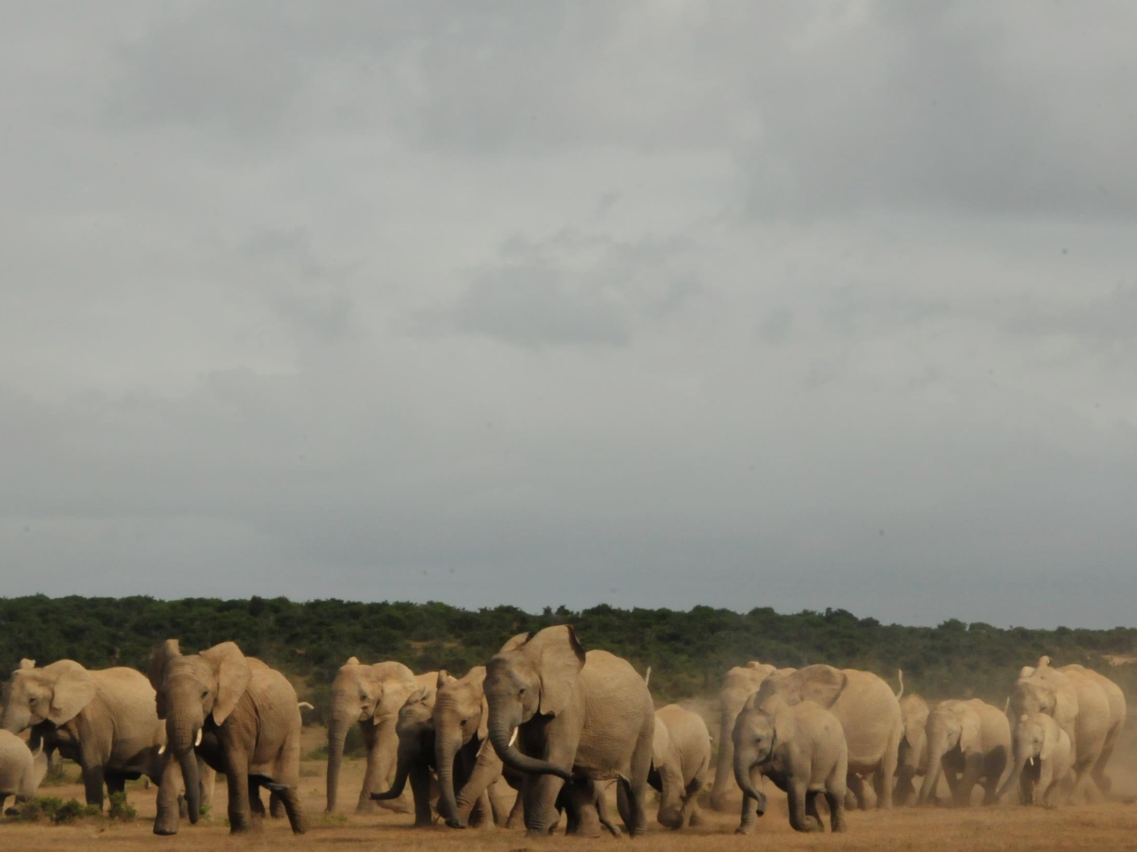
Kruger National Park
Gonarezhou National Park
Ferreira et al. 2020. Unpublished. Sample-based estimates of elephants in Kruger National Park, South Africa. SANParks, Skukuza, South Africa.
Zimbabwe Parks and Wildlife Management Authority. 2021. Zimbabwe National Elephant Management Plan. Harare, Zimbabwe
Jeanetta Selier
Notes:
• Let us consider some key lessons learned with for now the focus on Kruger.
• Both in Kruger and Gonarazhou elephants increased when population control stopped. In Gonarezhou populations indicate density-dependence in growth. Published work suggest stabilizing dynamics around 35,000 to 40,000 elephants in Kruger, around 10,000 to 15,000 in Gonarazhou, and around another 30,000 in Limpopo National Park.

Slide 5
Notes:
• So does this spell ecological meltdown for the future, let alone social melt-down?
• Let us explore some information.

Slide 6
Kruger recorded losing trees since 1940 at different rates on different soils and it continued during culling
Treefalls continued and vary over space and time disregarding elephant management
Elevation, soil, elephants and fire predicts treefall in that sequence.
Stevens et al. 2016. Woody encroachment over 70 years in South African savannahs: Overgrazing, global change or extinction aftershock? Philosophical Transactions B DOI: 10.1098/rstb.2015.043
Asner et al. 2016. Ecosystem scale effects of mega-fauna in African savannas. Ecography 39: 240-252.
Notes:
In Kruger, there was a record of trees falling since the 1940s. Trees were considered endangered & that 15% of debarked trees will have detrimental effects on them. Treefalls varied on landscapes & between time periods. 1940s to 1960s much were on basalts & later, also on granites. A key point is that trees kept on falling over during culling periods. Several studies highlighted that treefall is linked to elephant, soil, & fire. Elephant is an important explanatory factor - bulls more so than mixed herds. Woody cover, or shrubs, increase everywhere except when there are elephants present. Elephants thus acted as mediator of bush encroachment that are primarily resulting from increased atmospheric carbon.

Slide 7
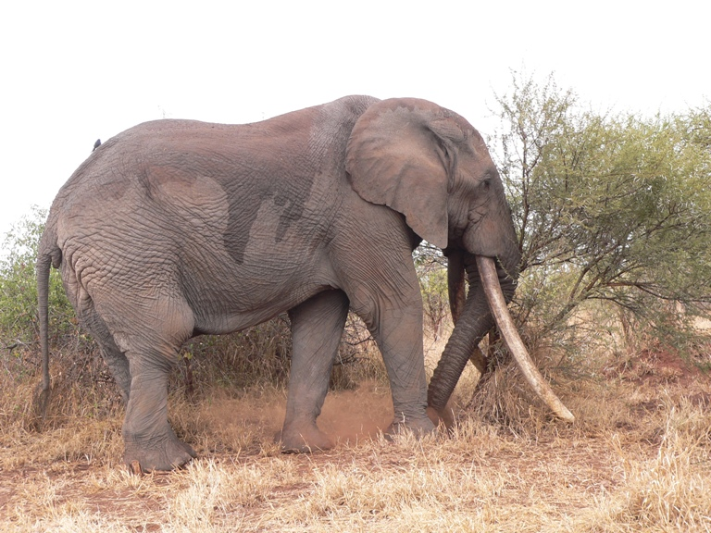
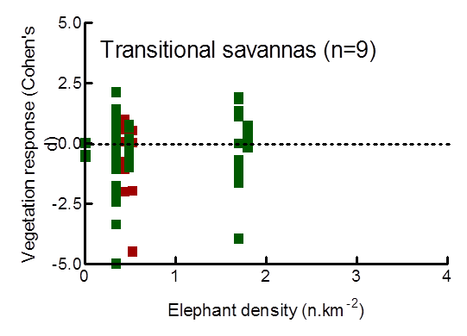
Restoring landscape dynamics in large areas
Published data do not support calls to reduce numbers to mitigate influences
68 years, 367 peer-reviewed papers
51 had credible data on elephant effects
Guldemond RAR, Purdon A, van Aarde RJ (2017) A systematic review of elephant impact across Africa. PLOS ONE 12(6): e0178935. https://doi.org/10.1371/journal.pone.0178935
Guldemond & van Aarde. 2008. A meta-analysis of the impact of African elephants on savanna vegetation. Journal of Wildlife Management, 72(4), pp.892-899.
Notes:
It is believed that elephant impact is associated with how many elephants there are. Scientific evidence cannot find a clear link between elephant impacts & elephant numbers. There is a lot of elephant impact, but impact is not everywhere the same or at the same intensity. An elephant in southern Kruger is not even aware of habitat & food in the far north. Elephants like certain trees - simply reducing numbers in the Park would not result in those elephants stop liking those trees & going to the places & use those trees. Some vegetation or species are more sensitive to elephant use than others. These finding from 370 odd scientific papers over a 70-year study challenge the key assumption of simply managing elephant numbers alone is enough to deal with elephant influences on nature or people.

Slide 8
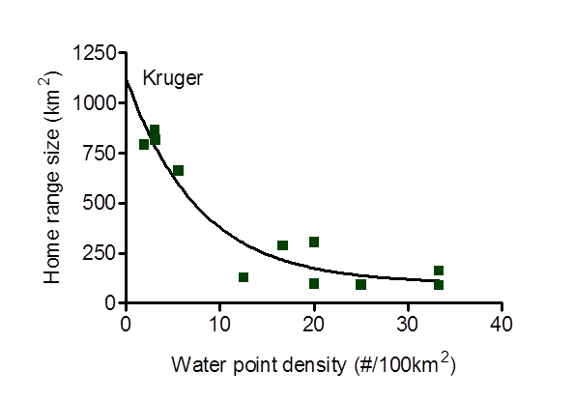
Large mammals as drivers of conservation values
Brown circles – people
Red line - river
 | Overlap
Kruger | 75%
Elsewhere | 0-35%
Notes:
The influence of large mammals, like elephants, linked to how intensely they use specific localities. Our context influence that a lot. On the left is an illustration of what may have been the historical setting for elephants & suitable habitat. Small dry season home ranges focused on water, come the wet season water was distributed more widely, & elephants used those areas. The outcome is that seasonal wet & dry season home ranges did not overlap much and during the growing season ecological systems could respond in the absence of intense elephant use. Today, we have fragmented elephant habitat, we keep elephants in confined areas, typically in South Africa by fences, place water all over the landscape & lead elephants to use the same areas both in the wet & dry season.

Slide 9
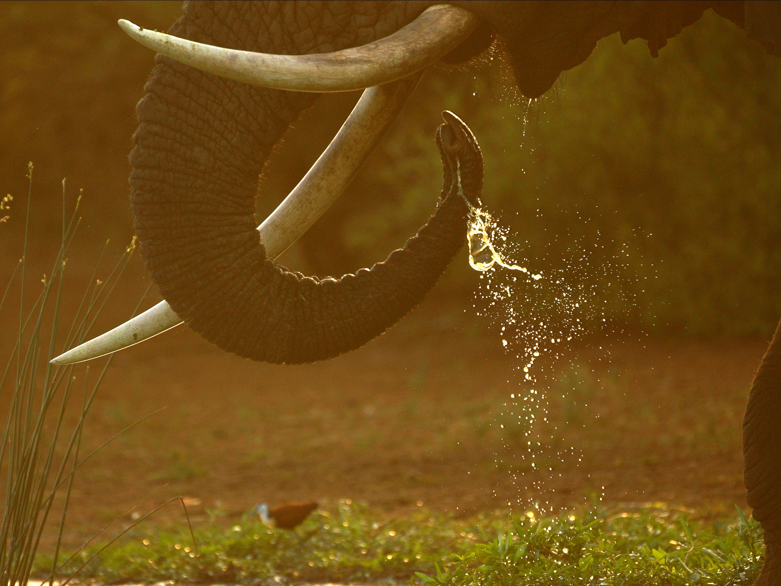
A paradigm shift
  Manage resources of elephants to mitigate impacts & conflicts differently in different places and at different times
Notes:
The reflection suggest a paradigm shift is required to compliment our understanding thus far. Elephant impact is local, & associated with water, food comfort & safety – this determines how much time elephants spent at a locality. Authorities need to manage the locality where elephant impact takes place rather than simply reducing elephant numbers. This require defining what exactly is making elephants spend lots of time at a locality. Do interventions to interfere with the mechanisms that make elephants spend a lot of time at a place. It means managing impacts, not elephants, & do so differently at different places at different times. Manipulating an essential resource, water is a first start. For example, population growth was reduced substantially following water closures in Kruger despite stopping the culling of elephants.

Slide 10
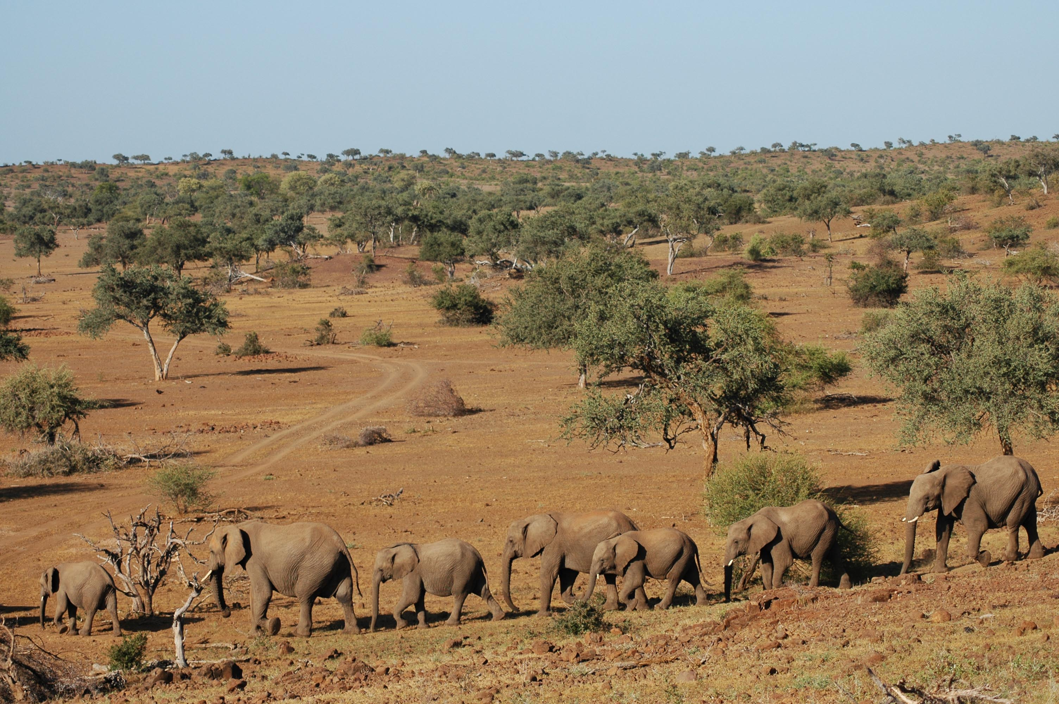
Regulating population dynamics takes place when management intensity is low
Culling & water
Post-Culling & less water
Growth rate
Robson, 2015. Demographic responses to changes in conservation management. MSc thesis UP.
Jeanetta Selier
Notes:
Apart from consequences on how elephants use landscapes there were other consequences. I.e., population regulating mechanisms never realized during the period of intense management. But we started seeing reduction in population growth rates at times when management intensity reduced.

Slide 11
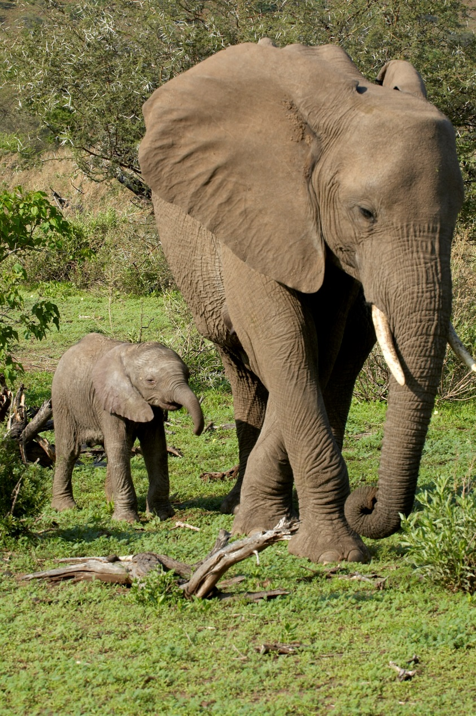
Notes:
What drives population growth? Evolutionary processes. Combine with duty of care principle. Management actions maintain, restore, or mimic ecological processes through minimal intervention.
Evidence-based interference & management align to support site specific objectives.
Duty of care towards providing opportunities for coping strategies to play out.
Duty of care towards minimizing harm, & if unavoidable, mitigate harm.
Mitigate unintended risks & consequences.
Learning by doing through strategic adaptive management.
Thrivability enriches people & nature alike.

Slide 12
Notes:
Some of these patterns link to responses of vital rates. Ecological theory suggest that as densities & competition for resources increase, or resources vary, first juvenile survival decrease, then reproduction decreases & lastly adult survival decreases. Across Africa we see that the 1st year of independence from a cow result in lower survival when cow’s daily distances of movements increase. Density dependence result from limiting factors on weaned calves in the 1st year after weaning. These often result from various mechanisms including predation. It does not mean thousands of calves are dying – if mortality rate is 5%, a few % increase can have substantive consequences on overall population growth. This process reflects the natural dynamics which elephants evolved coping mechanisms for.

Slide 13
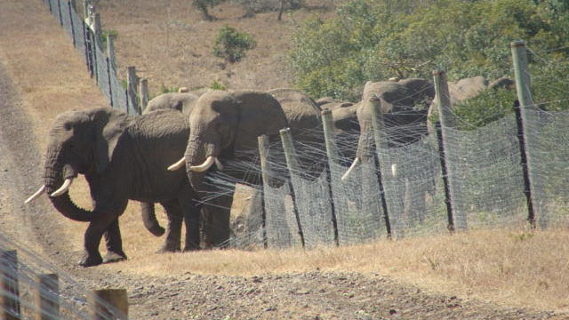
Cows Bulls
Henley, M.D.; Cook, R.M.; Bedetti, A.;Wilmot, J.; Roode, A.; Pereira, C.L.; Almeida, J.; Alverca, A. A Phased Approach to Increase Human Tolerance in Elephant Corridors to Link Protected Areas in Southern Mozambique. Diversity 2023, 15, 85.
Notes:
The reality is within the GLTFCA no country has its “own” elephants. This paper highlight how cows on the left, as well as bulls on the right move freely and increasingly are doing this. It is a great illustration of the TFCA concept working, but it create challenges – i.e., elephant interact more with people, while they interact less with some ecological areas of concern. Even so, changes in elephant estimates from year to year are greatly influenced by how elephants move to and from adjacent areas to Kruger. These dynamics are also very real for Mapungubwe and Tembe – should ask why continue with contraception to control populations in Tembe, if population growth are hugely influenced by other elephants arriving or leaving the Park? Similarly, because Kruger has a large set of gradients of environmental variability integrated into the greater Kruger region, controlling numbers through whatever means incl contraception is illogical.

Slide 14
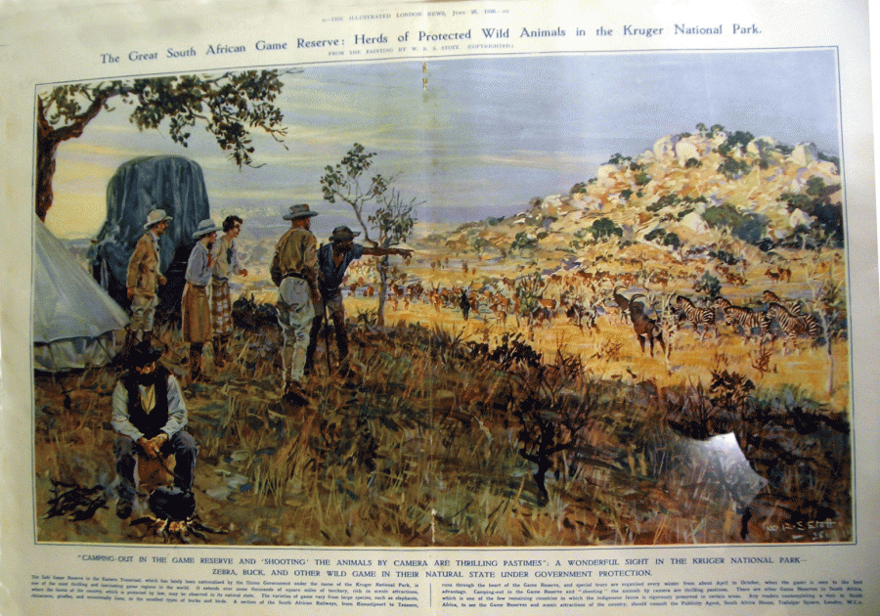
Restore spatial dynamics, else mimic outcomes
Drivers of elephant spatial use:
  Water availability
  Food availability
  Comfort
  Landscape of fear
www.environmentandsociety.org
Notes:
This brief reflection highlighted that elephants alone do not dictate systems. Often it is in concert with other factors, or not even a factor at all. Various combinations and heterogeneity in the combined effects of elephants and fire. Across South Africa we have done many interventions. In Kruger, authorities have varied densities, closed water and dropped fences. Authorities have burned in different ways. What we have not done is focus on the local impacts and reduce local intensity of use by elephants. Let’s see if there is something additional that can help guide South Africa

Slide 15

Managing impact on a local scale because of mismatch between impact & how elephants use landscapes
Areas of increased vigilance
Know where danger is
Don’t know when
Don’t know type
Cromsigt et al. 2013. Journal of Applied Ecology 50: 544-549
At the landscape scale, the decision is made on where to be within the landscape, and then on the finer spatial scale, the decision is on how to utilise the local resources. Selier et al., 2016
Spatial responses to stress associated with danger
Spatial refuge
Temporal refuge
Sam Ferreira
Notes:
Authorities identified several areas of concern that would contrast the Park’s objectives. In general, there were 8 types of concern. 4 of those associated with ecological concerns & vegetation impacts. 2 associate with undesirable influences on people – i.e. DCAs and expectations from external stakeholders. One associated with infrastructure, & 1 with areas that are poaching hotspots. Unpacking the mechanism leading to why elephants use areas intensely identifies several mechanisms. These link to the traditional expectations – water, seasonal and preferred food. Humans used certain areas for cultivation, usually close to perennial rivers. They also had focal areas of use usually around things like mineral deposits &associated with these sedentary uses, there were also use of areas for hunting activities. Even so, historical human presence varied spatially – the darker brown areas are where historical human activity was the most intense. There seem to be a high overlap between where people used to live & where elephants may now have influences that could contrast the Park objectives. These additional realization is very helpful & provide new & innovative approaches to manage elephant impacts (& conflicts). It helps address the conundrum that impacts do not associate primarily with elephant numbers. That’s is because the way elephants use a landscape over a large-scale mismatches with where elephant impact is. Ecological consequences are at a small local scale. SANParks seek to find ways to mimic the effects of human presence on elephant spatial use at a local scale. It embeds in theories of spatial requirements for elephants associated with offloading stress linked to danger. The key requirement is how to disturbed elephants at these local scales that mimics these gradients of dangers allowing elephants to respond to that through the coping strategies that they have evolved. The present Norms & Standards provide significant constraints on such informed approaches.

Slide 16
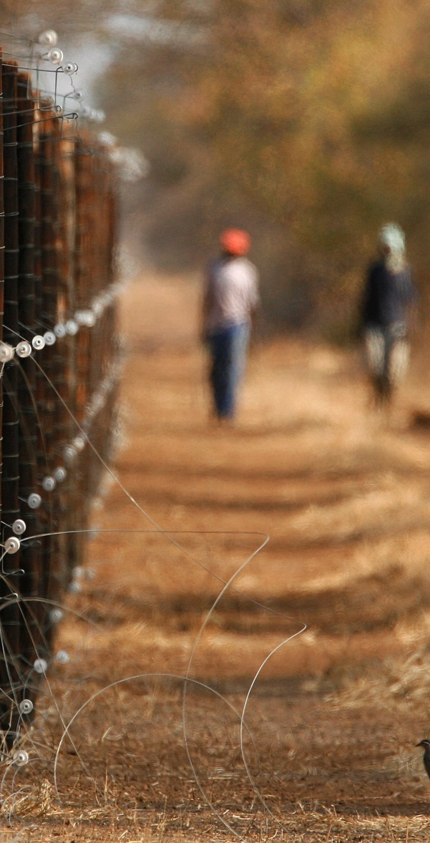
Challenge…
Small to medium-sized reserves in South Africa
Can we apply what we learned on big reserves on small to medium-sized reserves?
  Conservation and management of elephant populations on small and medium-sized fenced reserves: Current practices, constraints and recommendations. Bothalia African Biodiversity & Conservation, Vol. 48(2) 2018.

Slide 17
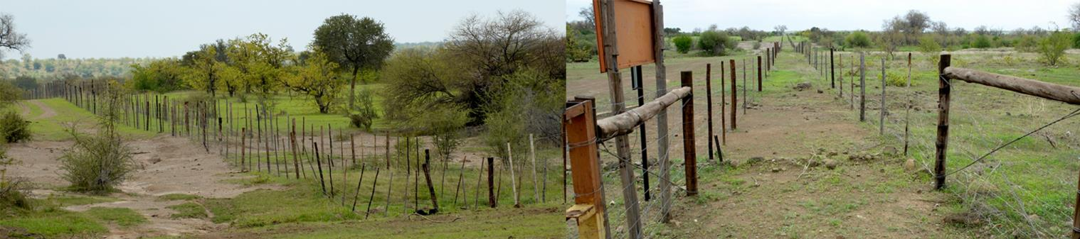
Management challenges
Majority of properties too small to sustain viable populations
  >55% of properties <30 elephants; 3 properties >1000 elephants
Rapid growing populations
  High resource availability, no dispersal
Dysfunctional populations
No gene flow between population – inbreeding
Impact on biodiversity
Scholes & Mennell 2008. Elephant management: A scientific assessment for South Africa. Wits University Press, Johannesburg. Slotow et al. 2005. Population dynamics of elephants re-introduced to small fenced reserves in South Africa. South African Journal of Wildlife Research, 35(1), 23.
Notes:
Change to the structure and composition and impact on biodiversity is inevitable on all of the small reserves. Alternative biodiversity conservation strategies not provided.

Slide 18
Contraception controls numbers and not mechanisms of effects they have on the landscape.
Before
After
Delsink et al. 2013. Journal of Zoo and Wildlife Medicine 44(4S): S52–S74
Sam Ferreira
Notes:
Let’s briefly think about implications for most of the 84 odd small populations in South Africa where elephants live in confined & relatively small areas albeit under free-ranging conditions. When areas are confined & small, the gradients of food, water comfort & safety is too small to have landscape variability influence elephant dynamics. Typically, populations grow, & elephants use the landscape uniformly. Authorities control populations through contraception, but this is not enough on its own to manage the impacts of elephants on local scales. Authorities also need to manage the locality where elephant impact takes place on top of controlling elephant numbers. This require defining what exactly is making elephants spend lots of time at a locality. Do interventions to interfere with the mechanisms that make elephants spend a lot of time at a place. These approaches embeds in mimicking the outcomes of ecological processes.

Slide 19
Large Populations
Confined Populations
Maintenance mode
Re-active mode
Reduce densities
Pro-active mode
Restore resource gradients
Within province
Control growth
If not, within SA
Translocation
If not, within SADC
Force variable use of habitat
If not, within Africa
Force variable use of habitat
If not, euthanize
Mimic dispersal through meta-population
Guiding strategic decisions
Notes:
We can reason that when we are dealing with large transnational free-ranging populations we could be in maintenance mode – we restore resource gradients as best possible can force variable habitat of use. In confined populations we often are in a re-active mode doing damage control of a population that has gone beyond the ecological limits – we show due diligence & reduce numbers aggressively through several considerations before culling. In pro-active mode we control populations given that the resource gradients cannot do that for us, but we also force variable use of habitat. We also integrate our many small populations in a meta-population framework & thereby generate an overall population of 5,000 to 6,000 elephants in our small reserve that act as one population & make a significant contribution to elephant aspirations.

Slide 20
It is about where elephants are, what type of place they at, how sensitive that place is, what kind of elephant is there and what they are doing when they there based on food, water, comfort and safety.
Notes:
A key insight for South Africa then is that ecological influences of elephants is at a local scale. It is about where elephants spent time, how sensitive the place is that they at, what they doing & whether it is cows or bulls. Water, food, comfort & safety that elephant perceive in turn influence how elephants use the landscape. Elephant influences depend on that use at the local scale. These insights suggest that South Africa thus need to focus on manipulating landscape features to manage the influences of elephants on various conservation values.

Slide 21
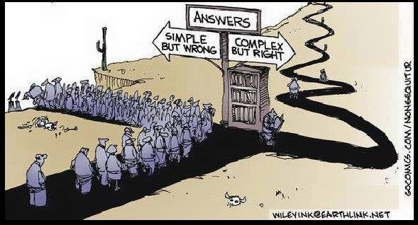
Notes:
Acknowledging that systems are complex take us away from an overbearing emphasis on recipes/blueprints/best practice/logframes etc. Towards a new and challenging domain where we devolve thinking and observing, sensing, probing and responding to the lowest sensible decision-making level

Slide 22
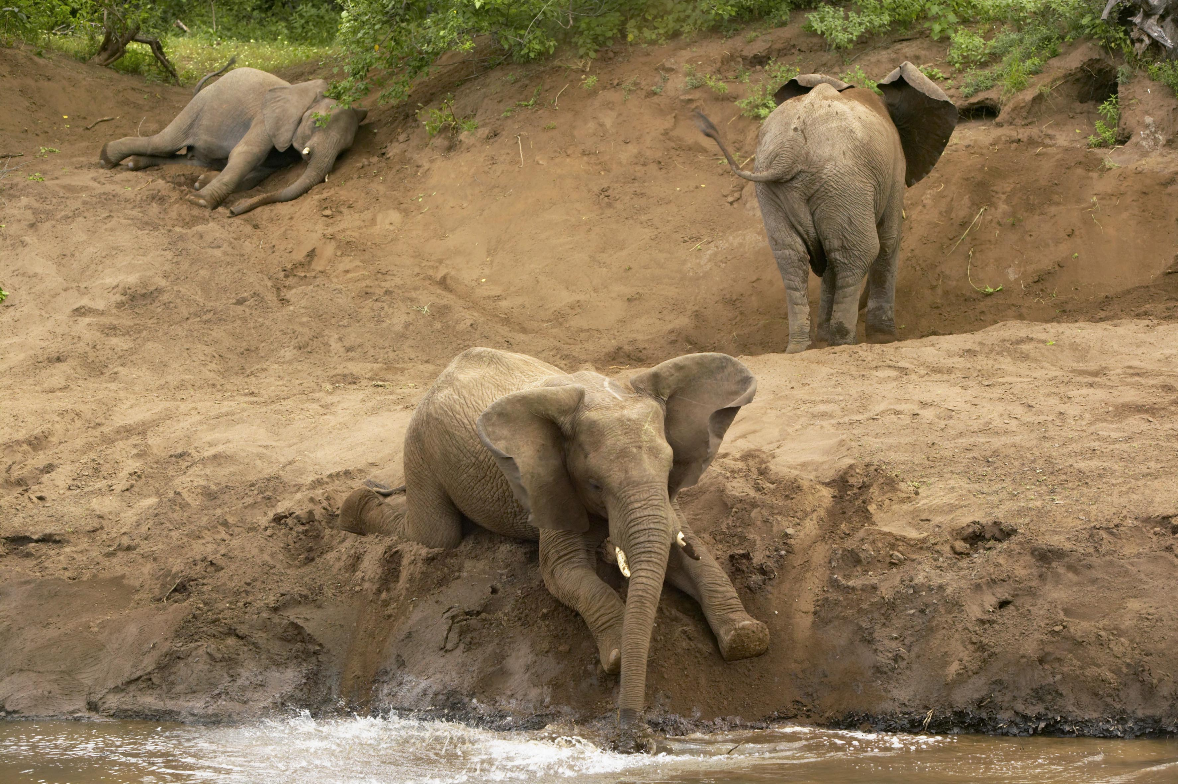
QUESTIONS?

