Slide 1
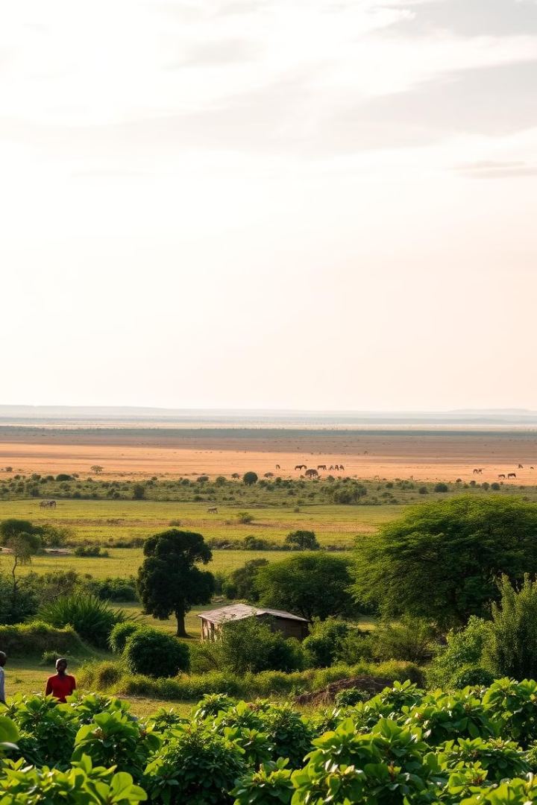
Protecting Our Habitat: A Future for Conservation, Tourism, and Communities
Join us as we explore the critical role you play in safeguarding South Africa's biodiversity and empowering local communities.
RN
by Rachel Nxele

Slide 2
The Stakes Are High
Rich Biodiversity
Habitat Loss
Ethical Hunting
South Africa hosts some of the world’s most biodiverse ecosystems.
Habitat loss threatens both wildlife and community livelihoods.
Ethical hunting plays a key role in conservation and the sharing of economic benefits.

Slide 3
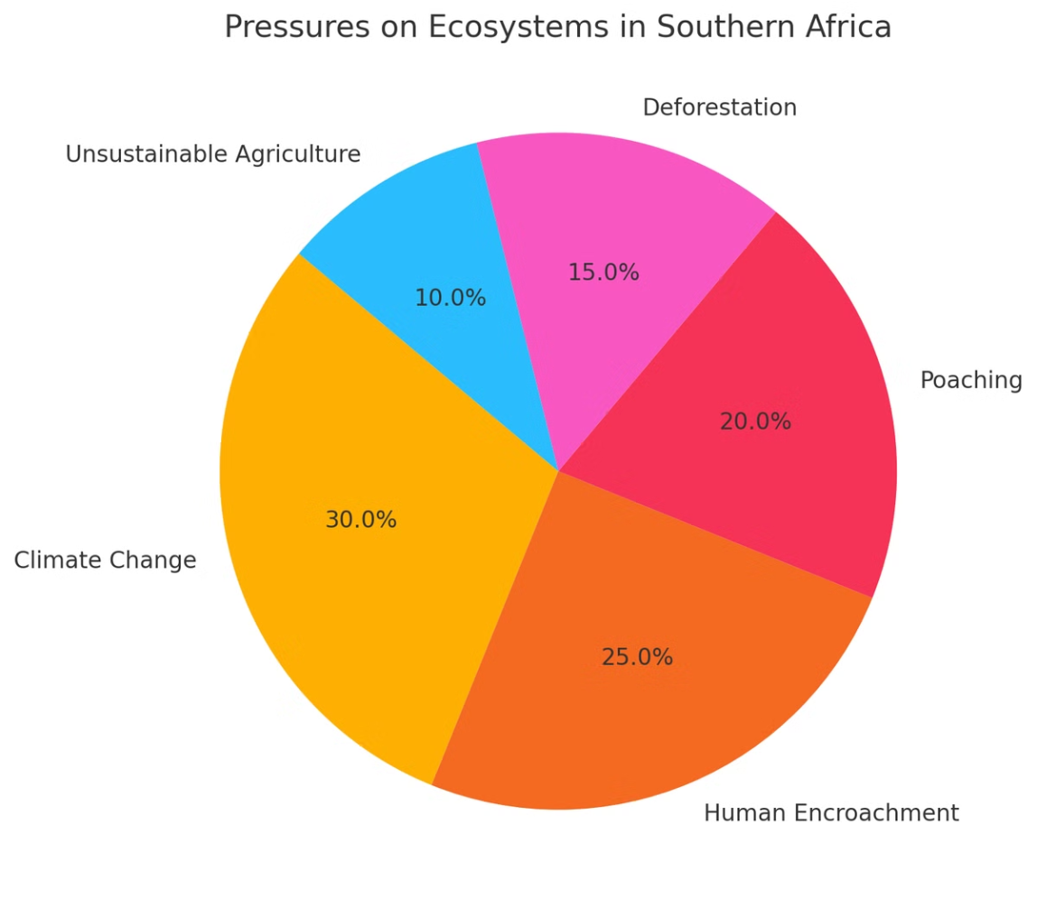
Challenges We Face Together
Balancing Priorities
Addressing Misconceptions
Balancing economic goals with conservation is crucial.
Addressing misconceptions about ethical hunting is essential.
Community Benefits
Sustainability Standards
Ensuring local communities benefit from conservation and tourism.
Navigating the push for sustainability standards and transparency.

Slide 4
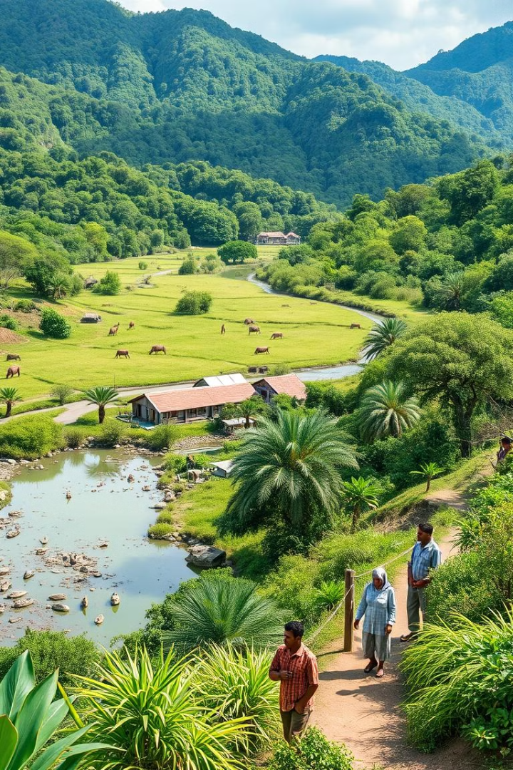
A Collaborative Vision
1
Conservation Funding
2
Community Participation
Ethical hunting and tourism can drive conservation funding.
Communities actively participate in and benefit from habitat protection.
3
Global Sustainability
Aligning with global sustainability standards to attract conscious travelers.

Slide 5
Framework for Action
Sustainable Practices
Community Integration
Aligning operations with global standards.
Creating economic opportunities for local communities.
Conservation Financing
Transparency & Marketing
Using tourism and hunting revenues to fund conservation.
Showcasing the impact of ethical hunting and tourism.

Slide 6
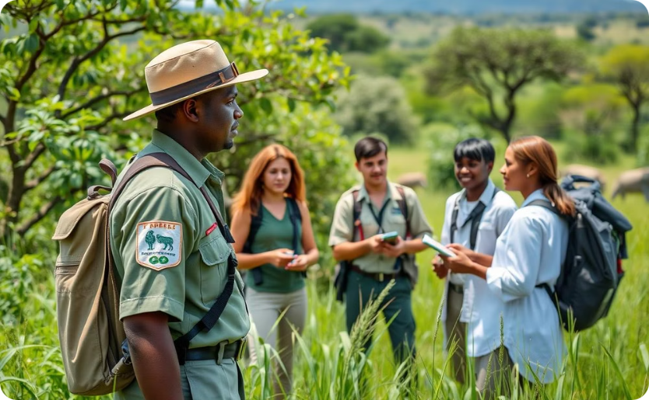
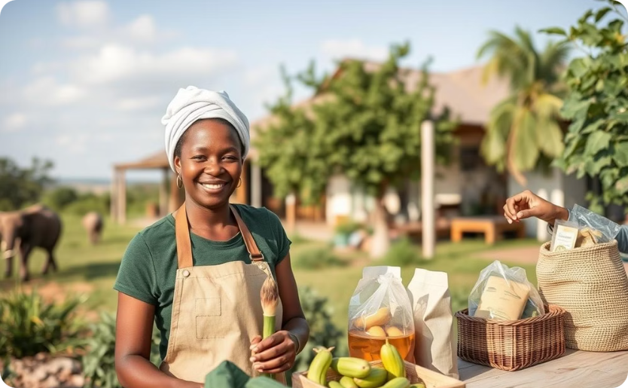
Success Stories - Our Context Matters
Reserve Revenue
Community Collaboration
Reserves use revenues to fund biodiversity research and anti-poaching units.
Game reserves collaborate with local farmers to supply sustainable products for lodges.

Slide 7
Engaging Communities for Habitat Protection
Co-Creating Opportunities
Local entrepreneurs supply services and goods to reserves.
Skills Development
Training programs for professional hunting guides and community leaders.
Shared Value
Using revenues to improve schools, clinics, and local infrastructure.

Slide 8
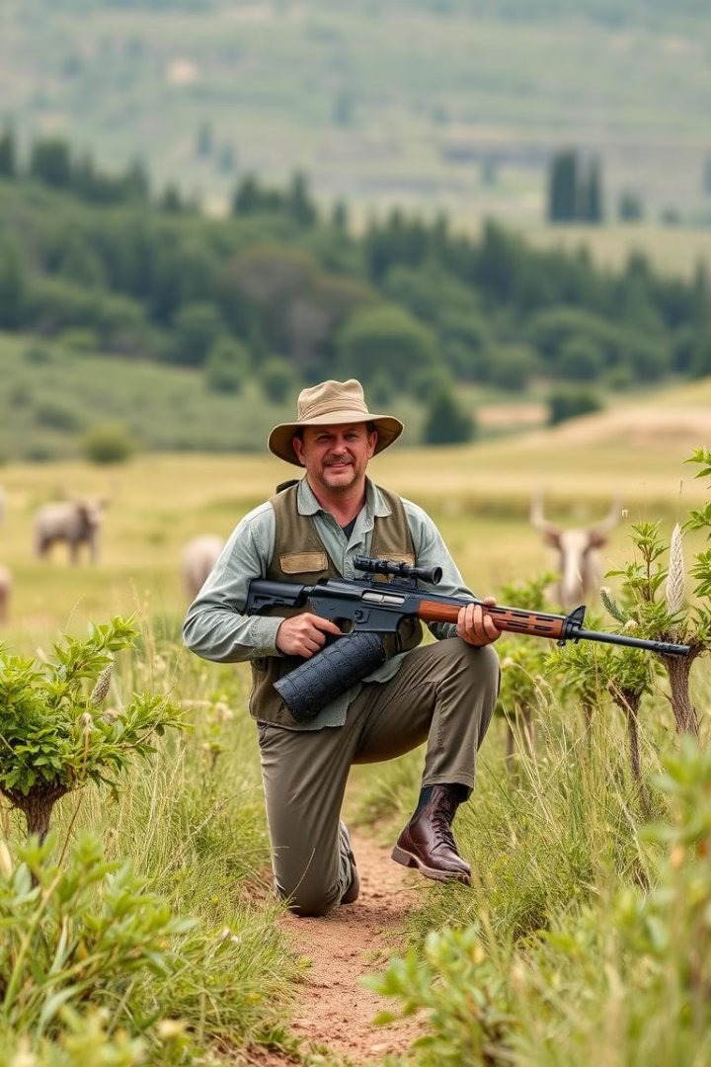
Transparency and Global Markets
1
Booking
A trip is booked through a reputable operator.
2
Conservation Impact
Revenues directly contribute to habitat protection.
3
Community Benefits
Community members benefit from employment and economic development.
4
Impact Reporting
Transparent reporting showcases the positive impact of ethical hunting.

Slide 9
Your Role in Protecting Our Habitat
1
Sustainable Tourism
2
Community Empowerment
3
Habitat Protection

Slide 10
Call to Action
1
2
3
Collaborate
Champion Sustainability
Share Success Stories
Join forces to overcome challenges and create lasting impact.
Advocate for ethical practices and promote sustainable tourism.
Showcase the positive impact of ethical hunting and conservation.

